Slide 1


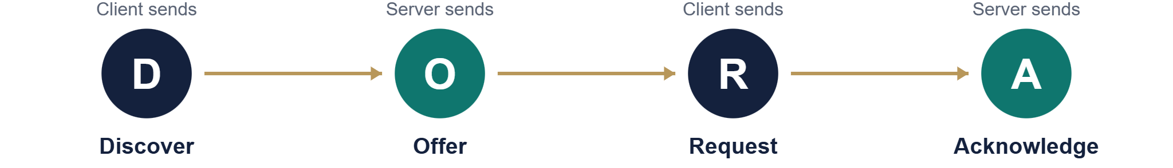
DHCP
Mawlana Bhashani Science and Technology University
Department of Information and Communication Technology
Dynamic Host Configuration Protocol
Data Communication Lab · ICT-3102
PRESENTED BY
SUPERVISED BY
Pritom Kumar Sen Anom
Dr. Nazrul Islam
ID: IT24061
Associate Professor
Session: 2023-24
Dept of ICT, MBSTU
Dept of ICT, MBSTU

Slide 2
Agenda
OVERVIEW
1
2
3
4
Basics
How it works
In practice
Trade-offs and security
The problem and what DHCP is
Ports, DORA and leases
Allocation, relay agents and messages
Advantages, attacks and comparisons
DHCP · Data Communication Lab · ICT-3102
2 / 20

Slide 3
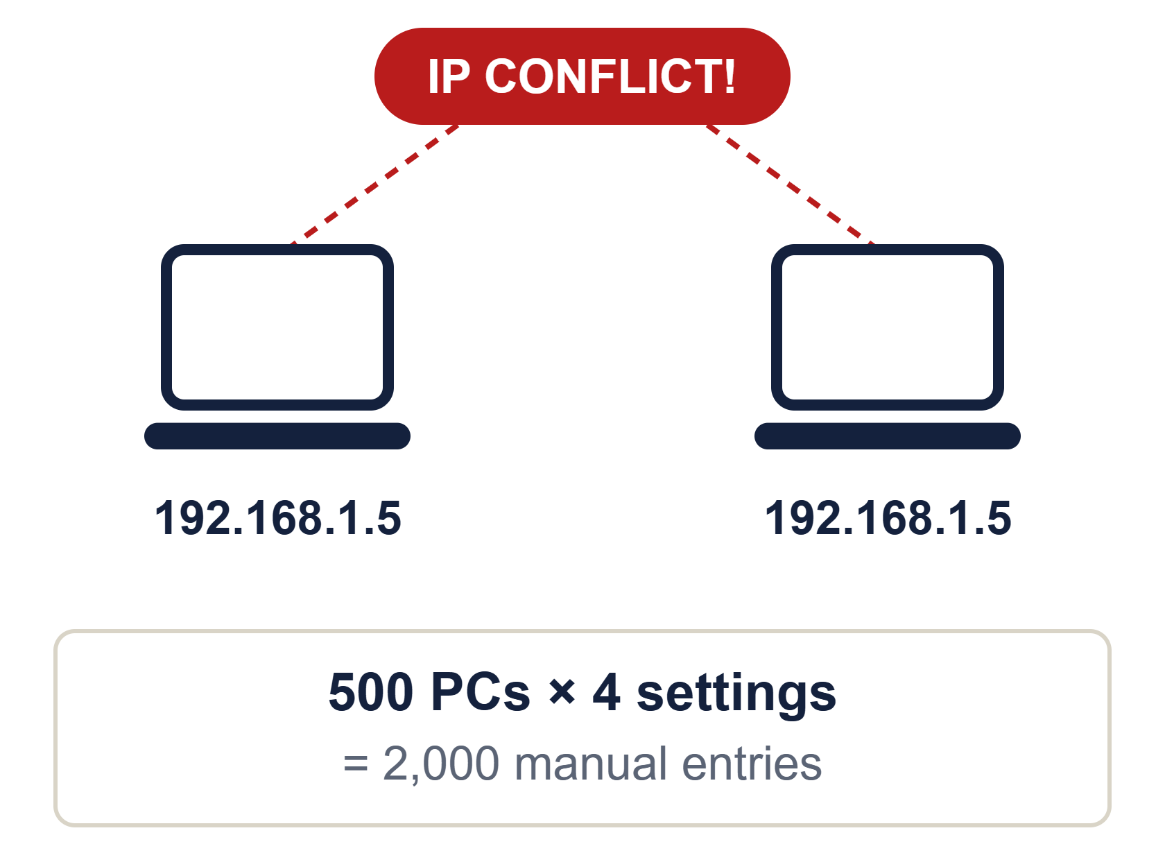
The problem: manual IP configuration
BASICS
Every device needs a unique IP, mask, gateway and DNS
Typing them by hand for hundreds of devices is slow
One typo creates a duplicate IP and a conflict
Moving a device to another network means redoing it
DHCP · Data Communication Lab · ICT-3102
3 / 20

Slide 4
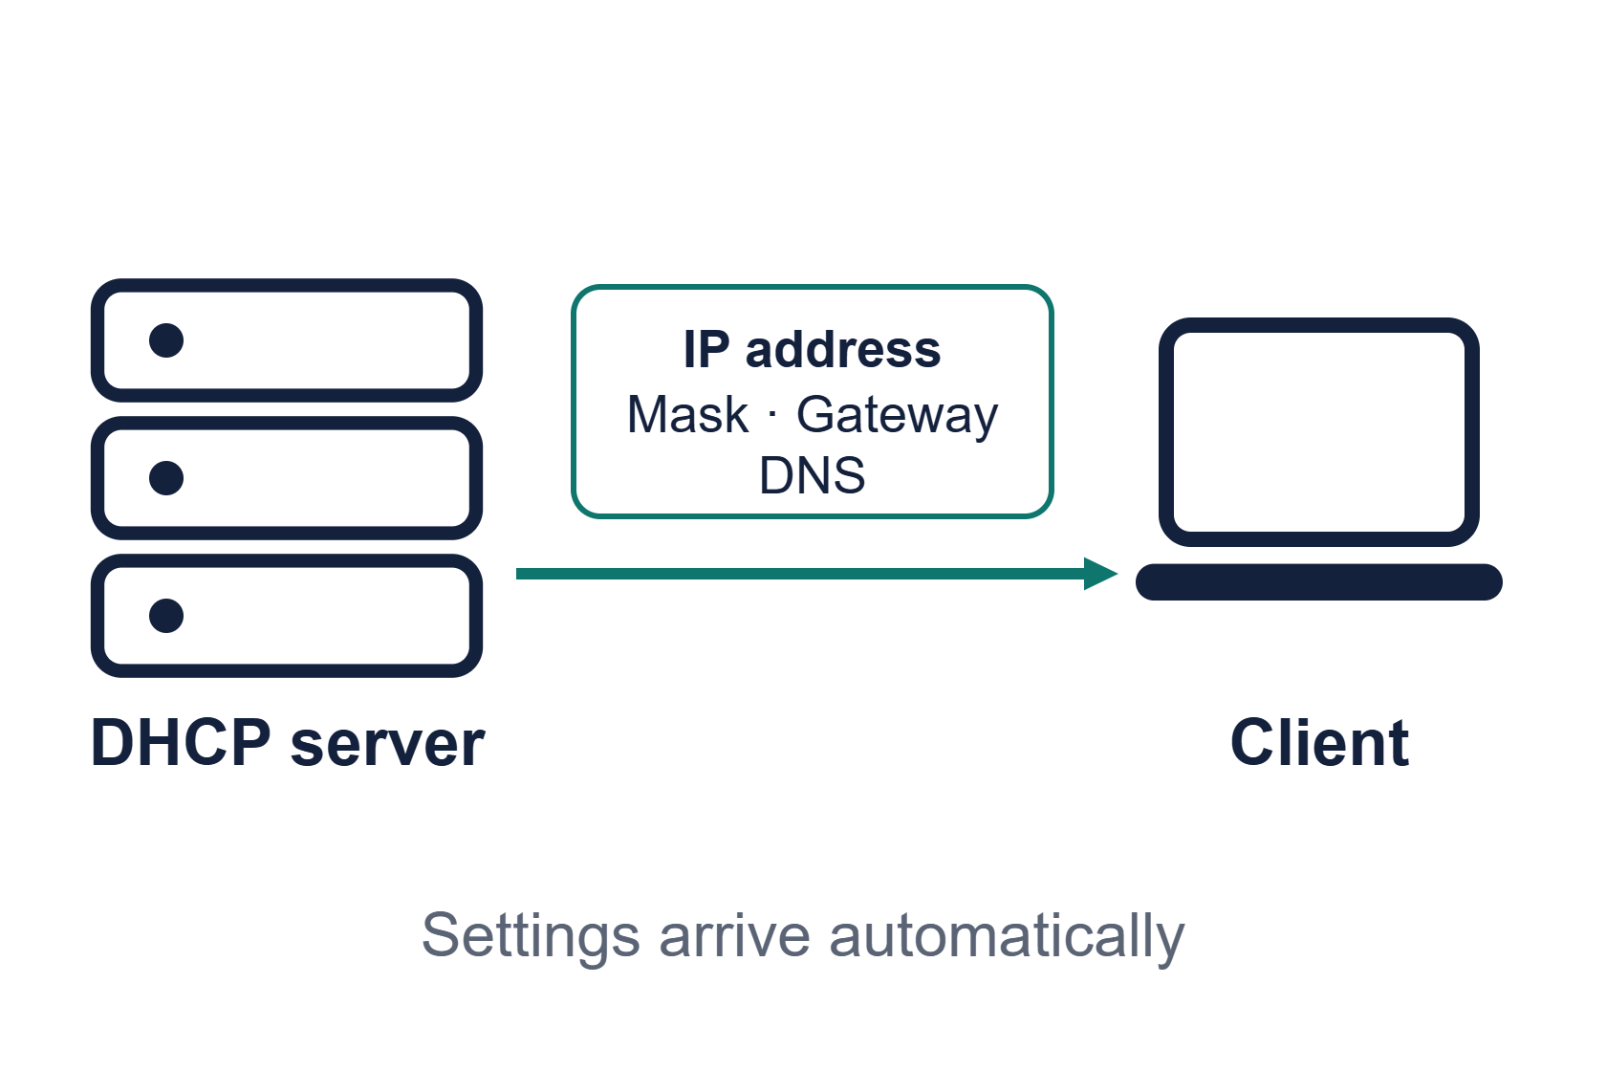
What is DHCP?
BASICS
DHCP is an application-layer client-server protocol that automatically assigns IP configuration to hosts joining a network.
A central server replaces manual setup on every device.
DHCP · Data Communication Lab · ICT-3102
4 / 20

Slide 5
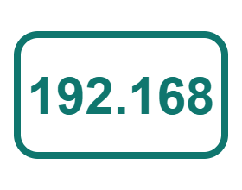



What DHCP assigns
BASICS
IP address
Subnet mask
Gateway
DNS server
Unique identity, leased for a limited time
Shows the size of the local network
Router used to leave the network
Turns names into IP addresses
DHCP · Data Communication Lab · ICT-3102
5 / 20

Slide 6
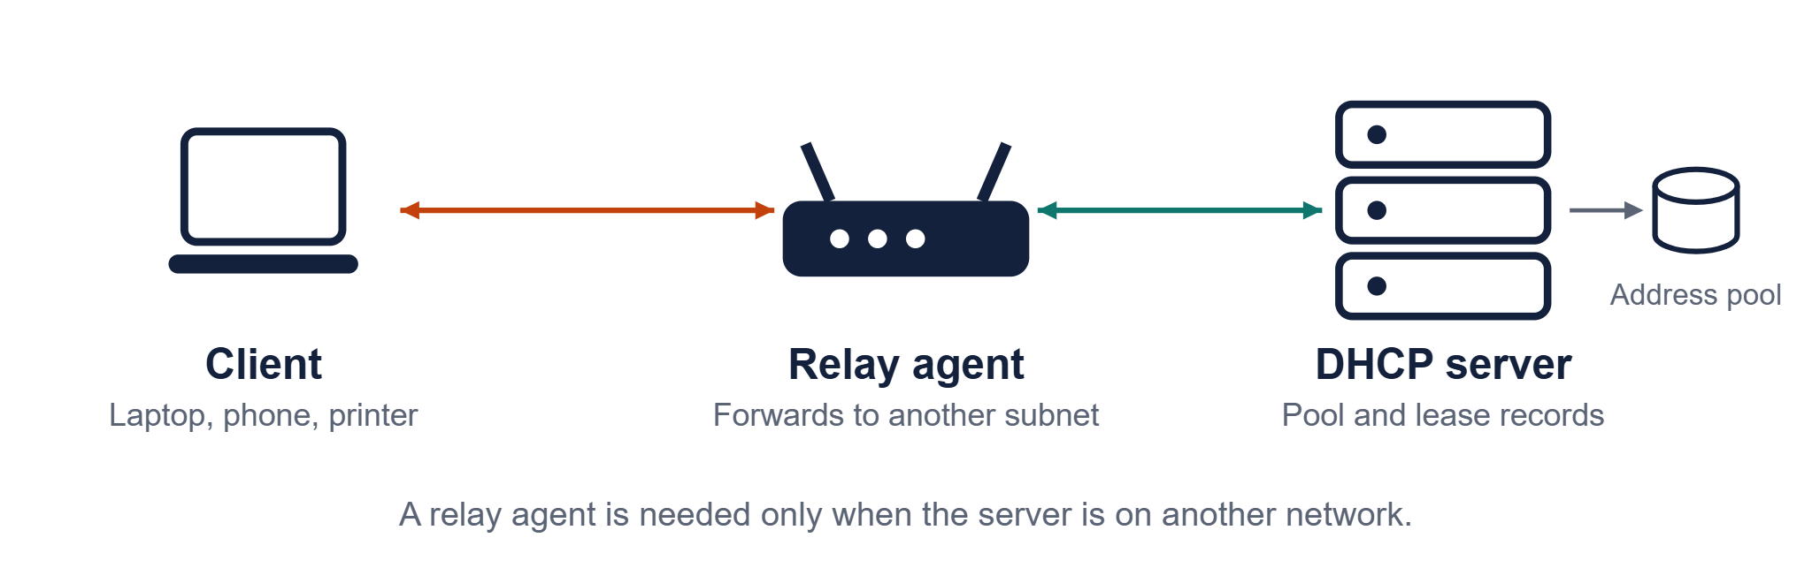
Client-server architecture
HOW IT WORKS
DHCP · Data Communication Lab · ICT-3102
6 / 20

Slide 7
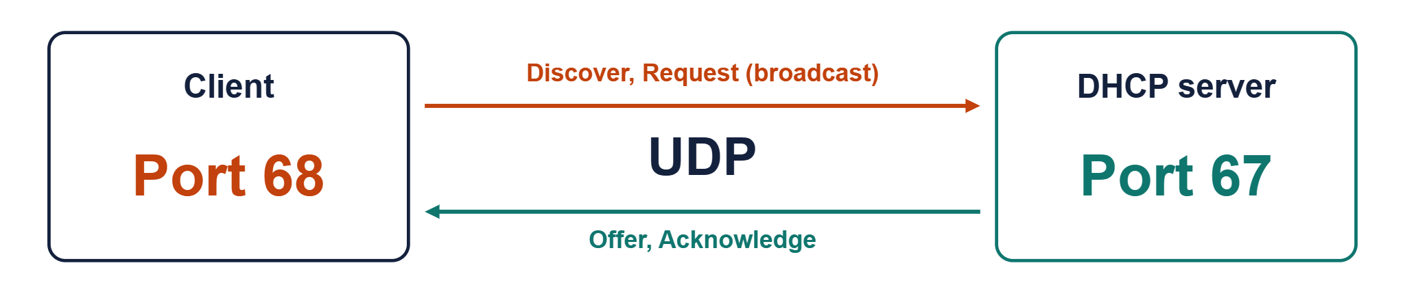
Ports and transport
HOW IT WORKS
Why UDP? The client has no IP address yet, so it cannot open a TCP connection. UDP lets it simply broadcast.
DHCP · Data Communication Lab · ICT-3102
7 / 20

Slide 8
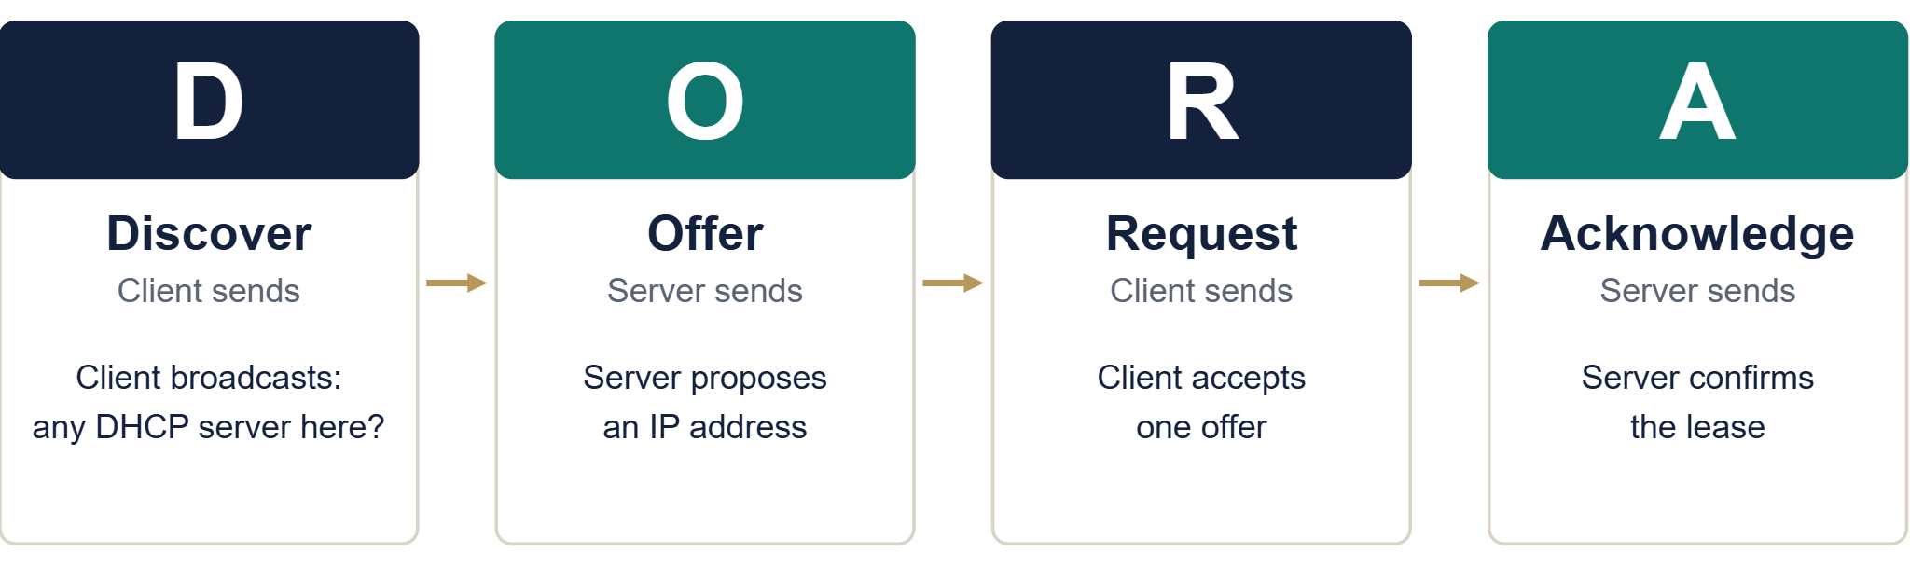
The DORA process
HOW IT WORKS
DHCP · Data Communication Lab · ICT-3102
8 / 20

Slide 9
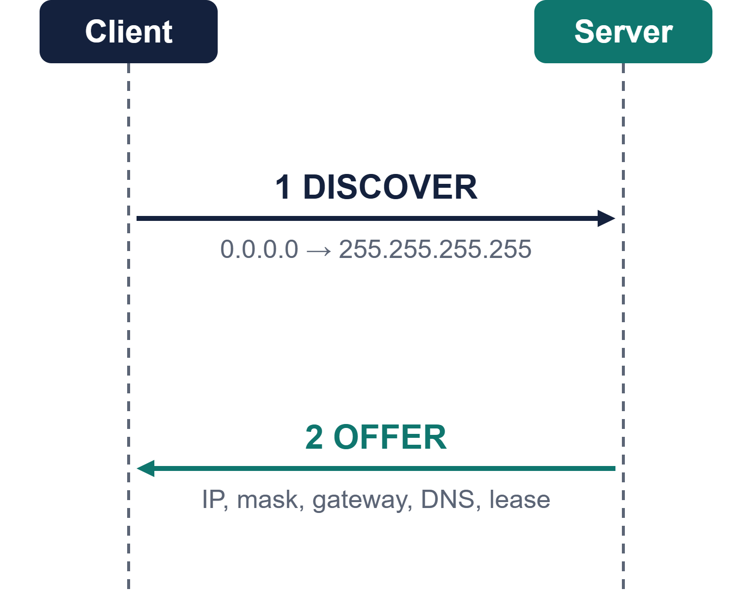
Discover and Offer
HOW IT WORKS
Discover
The client broadcasts from 0.0.0.0 because it has no address yet.
Offer
The server replies with a free IP address and a lease time.
DHCP · Data Communication Lab · ICT-3102
9 / 20

Slide 10
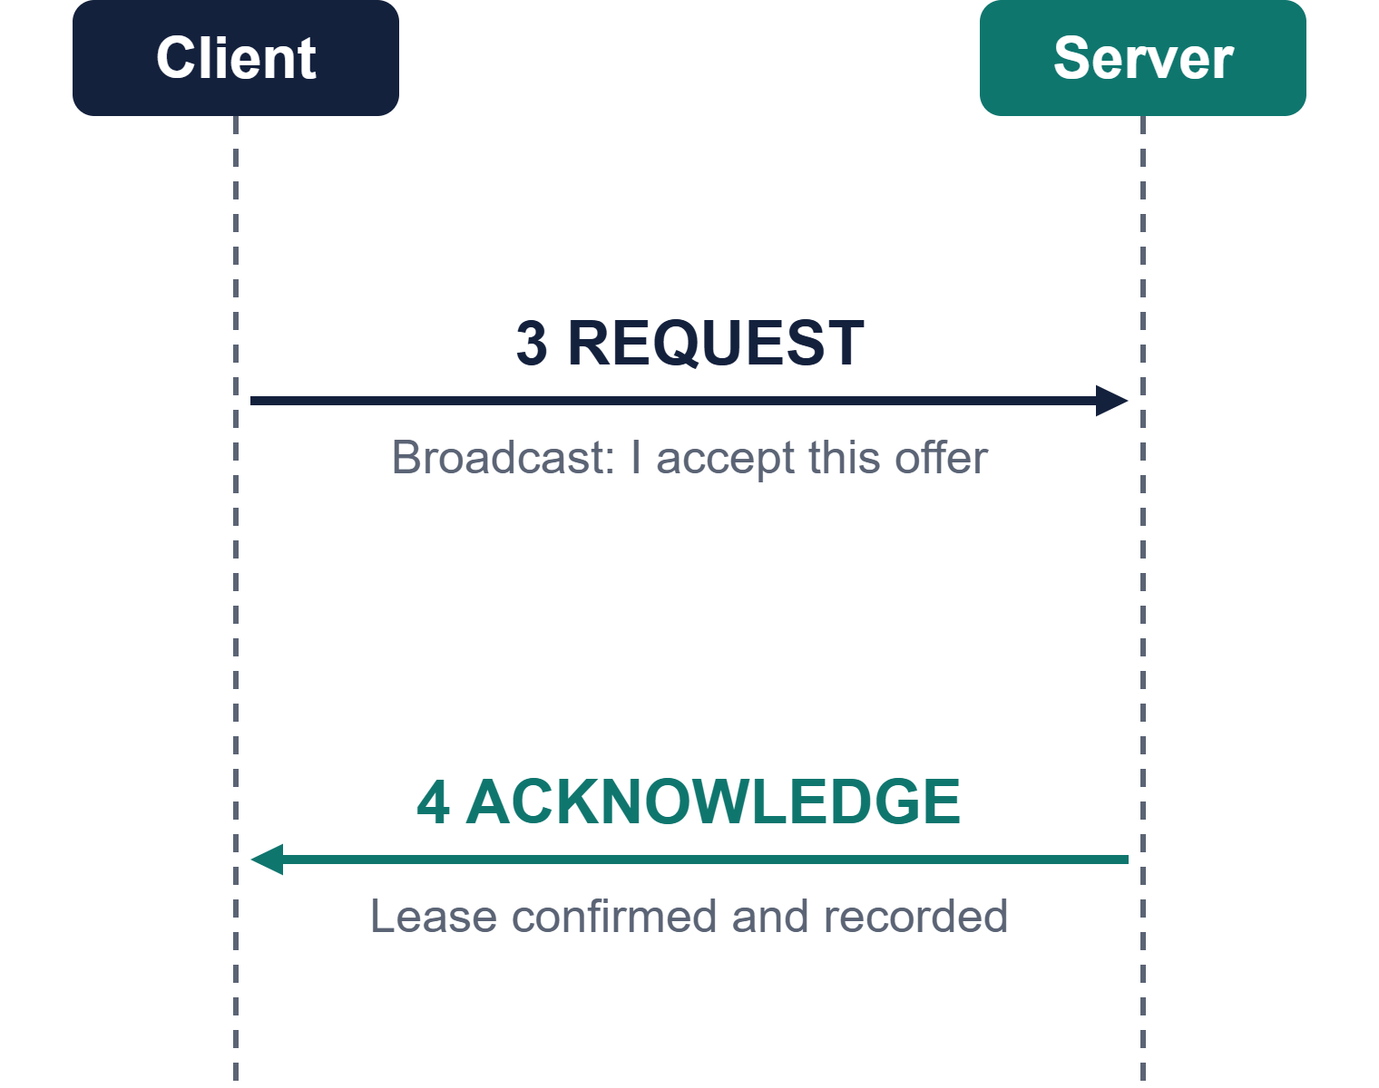
Request and Acknowledge
HOW IT WORKS
Request
The client broadcasts its choice, so other servers drop their offers.
Acknowledge
The server confirms the lease and the client configures itself.
DHCP · Data Communication Lab · ICT-3102
10 / 20

Slide 11
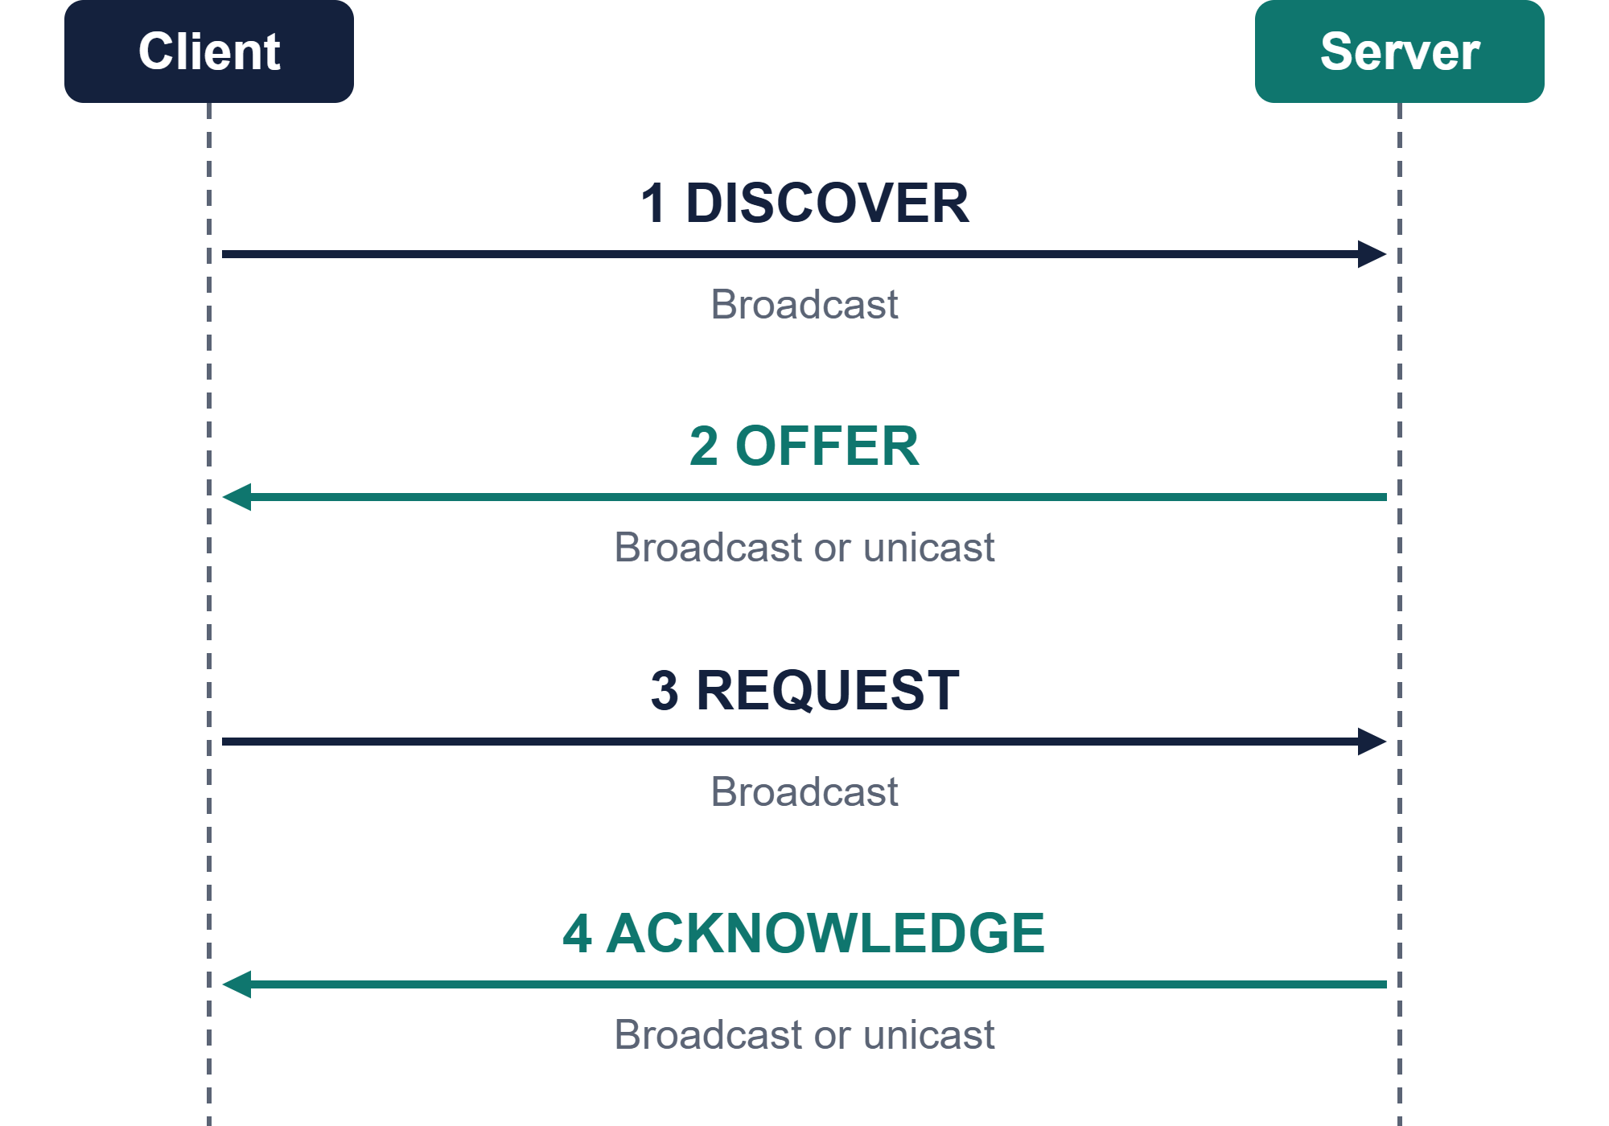
DORA packet flow
HOW IT WORKS
Client sends
Steps 1 and 3
Server sends
Steps 2 and 4
Broadcast vs unicast
Broadcast goes to all hosts. Unicast goes to one host.
DHCP · Data Communication Lab · ICT-3102
11 / 20

Slide 12
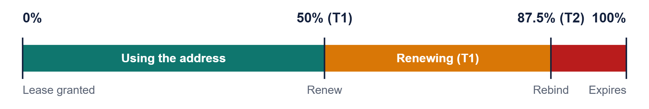
Lease time and renewal
HOW IT WORKS
T1 at 50%
T2 at 87.5%
100%
The client asks the same server to renew the lease.
The client asks any server to rebind.
The lease expires. The address returns to the pool.
DHCP · Data Communication Lab · ICT-3102
12 / 20

Slide 13
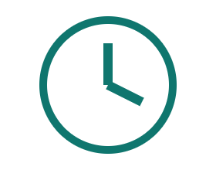


Allocation types
IN PRACTICE
Dynamic
Automatic
Manual
Address from the pool for a limited lease.
Address from the pool, kept for a long time.
Fixed IP tied to a MAC address (reservation).
Best for: Laptops, phones
Best for: Stable hosts
Best for: Servers, printers
DHCP · Data Communication Lab · ICT-3102
13 / 20

Slide 14
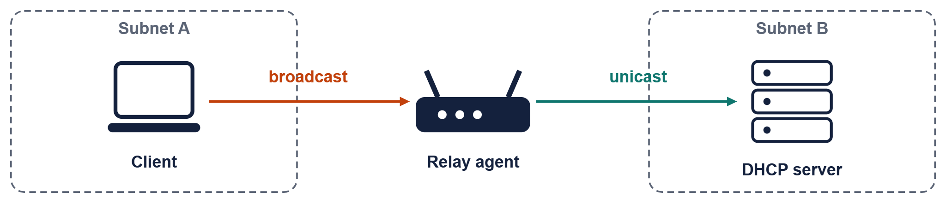
DHCP relay agent
IN PRACTICE
Routers do not forward broadcasts by default
The relay catches the client broadcast and sends it as unicast
One central server can then serve many subnets
DHCP · Data Communication Lab · ICT-3102
14 / 20

Slide 15
Other DHCP messages
IN PRACTICE
Sent by client
Sent by server
Decline
NAK
The offered address is already in use.
Request refused, so the client restarts DORA.
Sent by client
Sent by client
Release
Inform
Gives the address back before the lease ends.
Already has an IP and asks only for extra settings.
DHCP · Data Communication Lab · ICT-3102
15 / 20

Slide 16
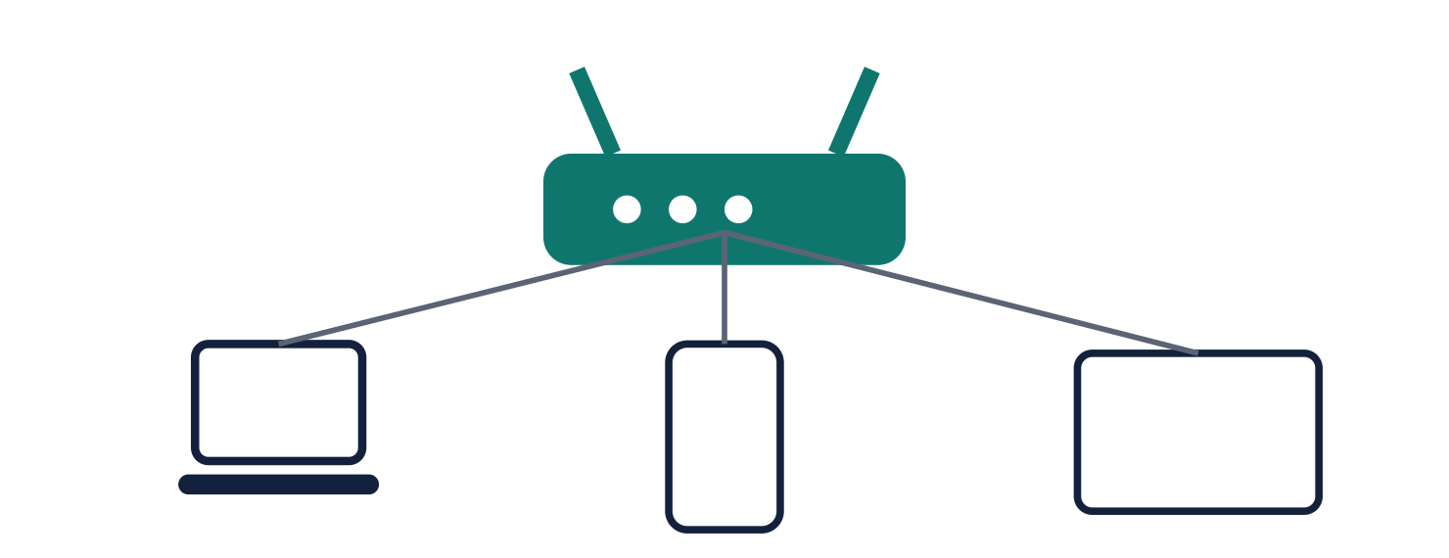
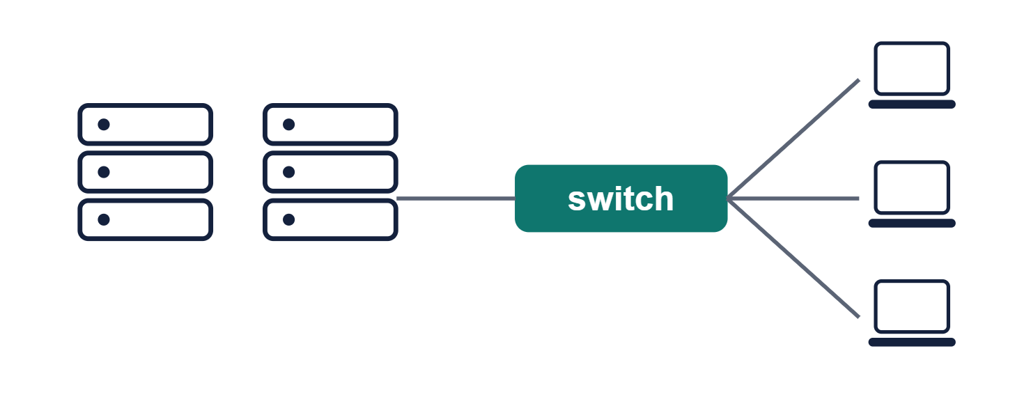
Home router vs enterprise
IN PRACTICE
Home router
Enterprise
Built-in server, one small pool, defaults rarely changed.
Dedicated servers, many scopes and VLANs, redundancy and reservations.
DHCP · Data Communication Lab · ICT-3102
16 / 20

Slide 17


Advantages and disadvantages
TRADE-OFFS AND SECURITY
Advantages
Disadvantages
Less admin work
Single point of failure without a backup server
No duplicate IP addresses
Rogue servers can mislead clients
Settings changed from one place
Starvation can exhaust the pool
Efficient reuse of addresses
DHCP · Data Communication Lab · ICT-3102
17 / 20

Slide 18
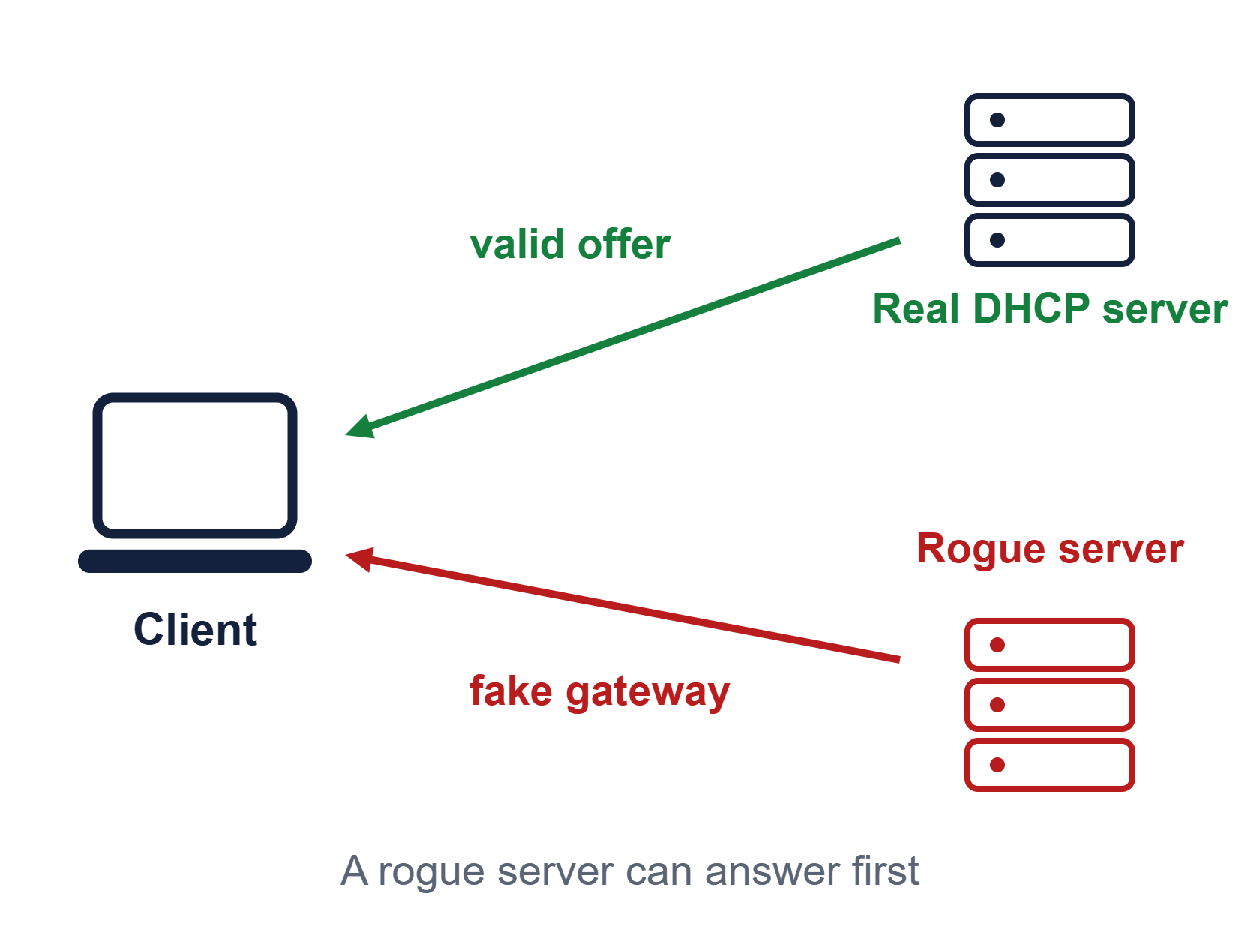
Security threats and defenses
TRADE-OFFS AND SECURITY
Threats
Rogue DHCP server
Starvation attack
Defenses
DHCP snooping on switches
Port security
Rate limiting
Backup DHCP servers
DHCP · Data Communication Lab · ICT-3102
18 / 20

Slide 19
DHCP vs static IP vs APIPA
TRADE-OFFS AND SECURITY
Feature | DHCP | Static IP | APIPA
Setup | Automatic | Manual | Automatic
Range | Any network | Any network | 169.254.0.0/16
Conflicts | Avoided | Possible | Possible
Gateway, DNS | Provided | Set by hand | Not provided
Tip: an address starting with 169.254 usually means the DHCP server could not be reached.
DHCP · Data Communication Lab · ICT-3102
19 / 20

Slide 20

Summary and Q&A
WRAP-UP
DHCP automates IP configuration
Thank you
DORA: Discover, Offer, Request, Acknowledge
Leases renew at 50% and 87.5%
Questions?
Relay agents let one server serve many subnets
Pritom Kumar Sen Anom
ID: IT24061
DHCP snooping protects against rogue servers
DHCP · Data Communication Lab · ICT-3102
20 / 20

